Slide 1


Power-BI Practice in sales data By-Subham Mittal

Slide 2
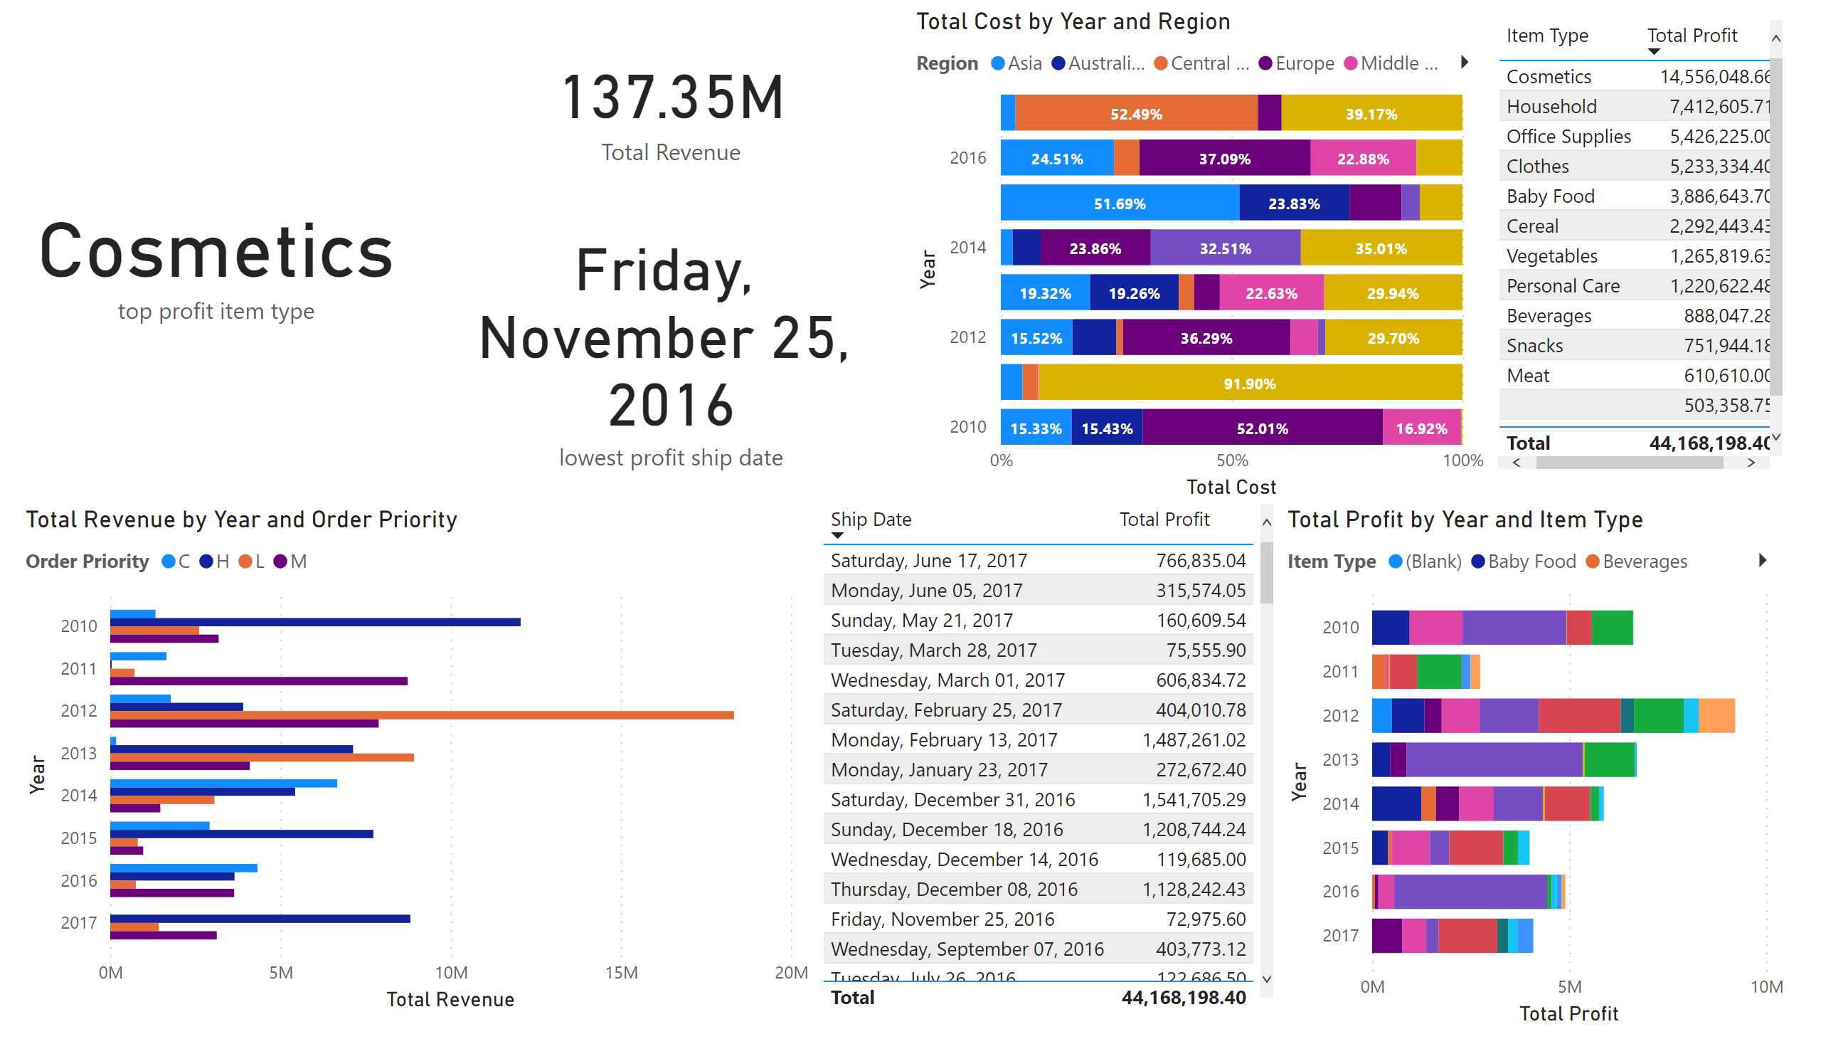
card chart
Notes:
barChart
No alt text provided
clusteredBarChart
No alt text provided
hundredPercentStackedBarChart
No alt text provided
card
No alt text provided
card
No alt text provided
tableEx
No alt text provided
card
No alt text provided
tableEx
No alt text provided

Slide 3
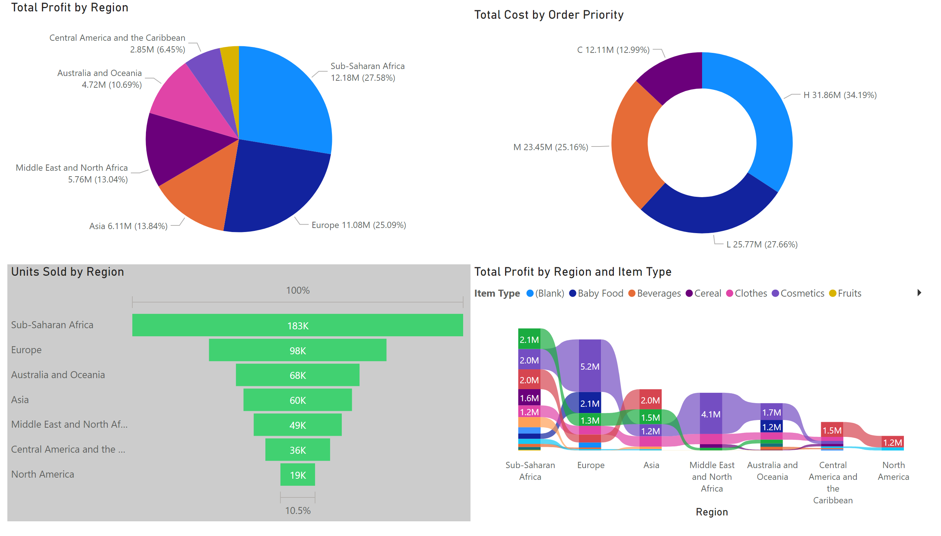
pie chart/funnel/ribbon
Notes:
pieChart
No alt text provided
donutChart
No alt text provided
funnel
No alt text provided
ribbonChart
No alt text provided

Slide 4
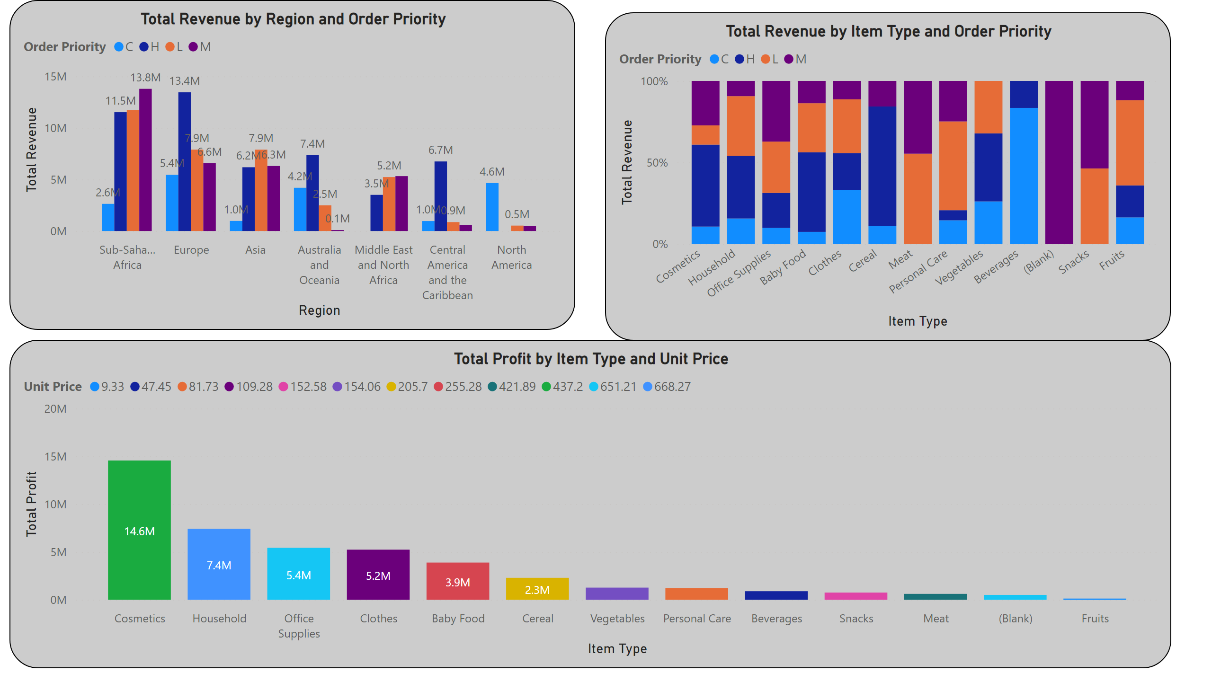
column chart
Notes:
clusteredColumnChart
No alt text provided
hundredPercentStackedColumnChart
No alt text provided
columnChart
No alt text provided

Slide 5
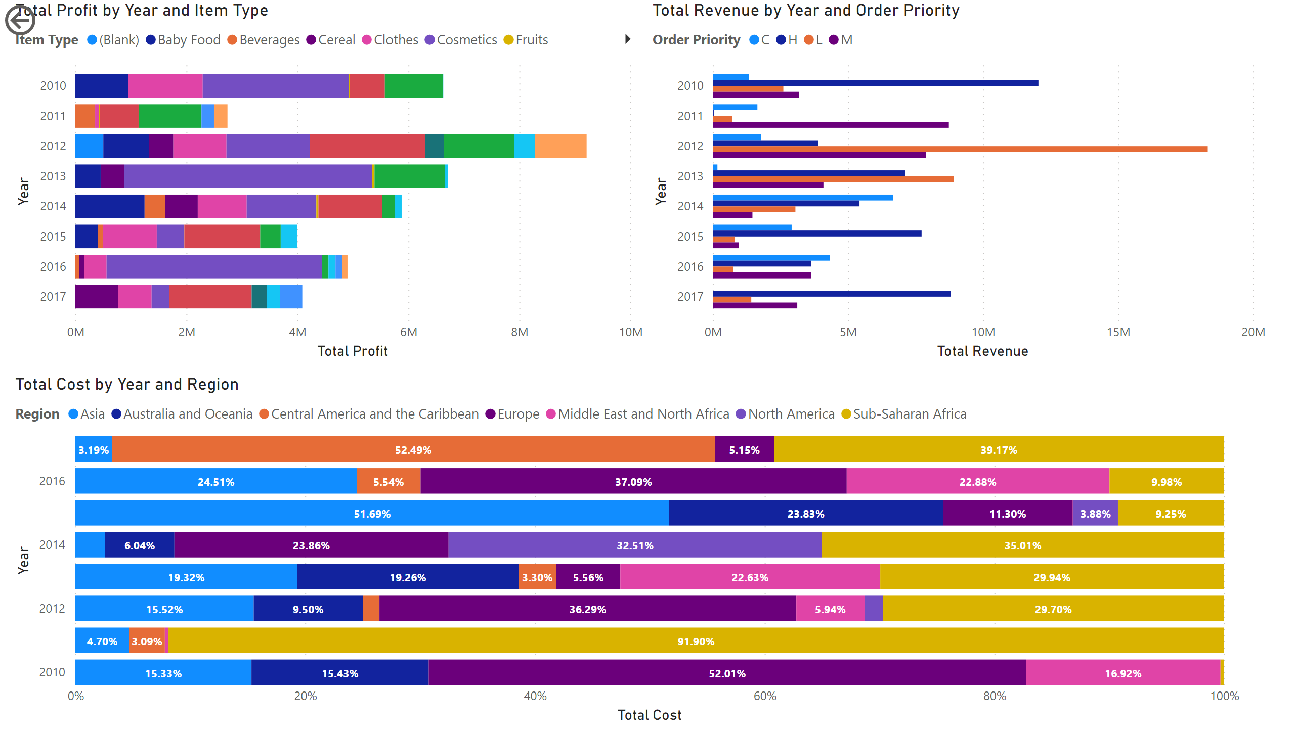
bar chart
Notes:
barChart
No alt text provided
clusteredBarChart
No alt text provided
hundredPercentStackedBarChart
No alt text provided
actionButton
No alt text provided

Slide 6
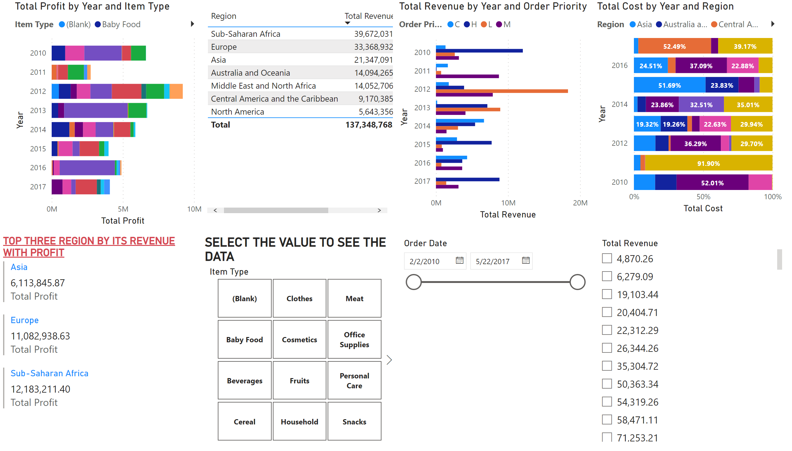
multi row cARD/SLICERS
Notes:
barChart
No alt text provided
clusteredBarChart
No alt text provided
hundredPercentStackedBarChart
No alt text provided
TOP THREE REGION BY ITS REVENUE WITH PROFIT
No alt text provided
tableEx
No alt text provided
SELECT THE VALUE TO SEE THE DATA
No alt text provided
slicer
No alt text provided
slicer
No alt text provided

Slide 7
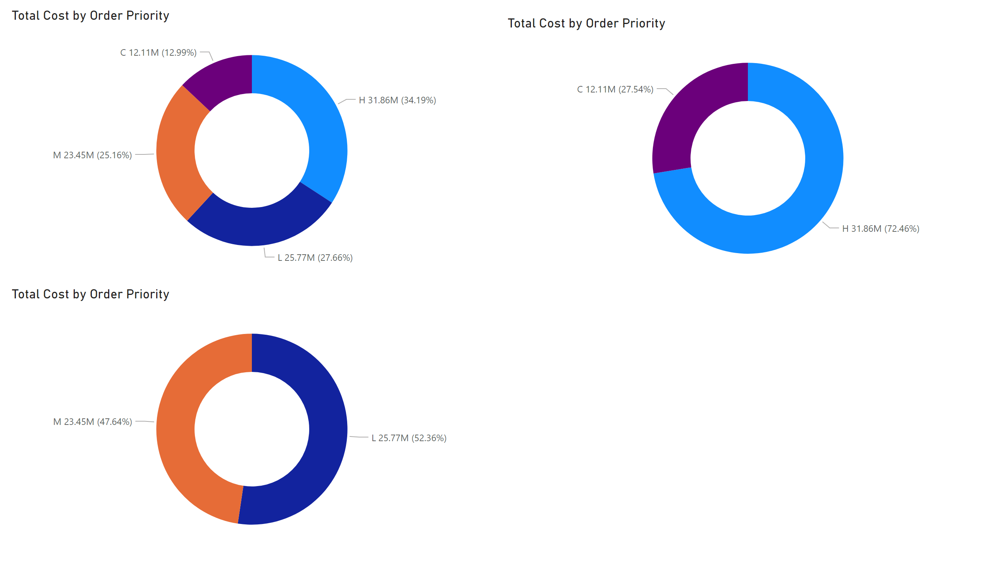
include/exclude/export
Notes:
donutChart
No alt text provided
donutChart
No alt text provided
donutChart
No alt text provided

Slide 8
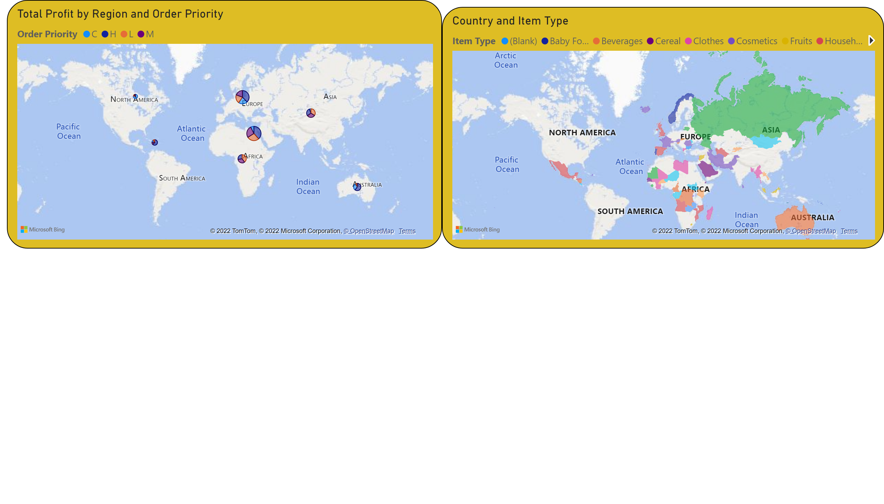
map/filled map
Notes:
map
No alt text provided
filledMap
No alt text provided

Slide 9
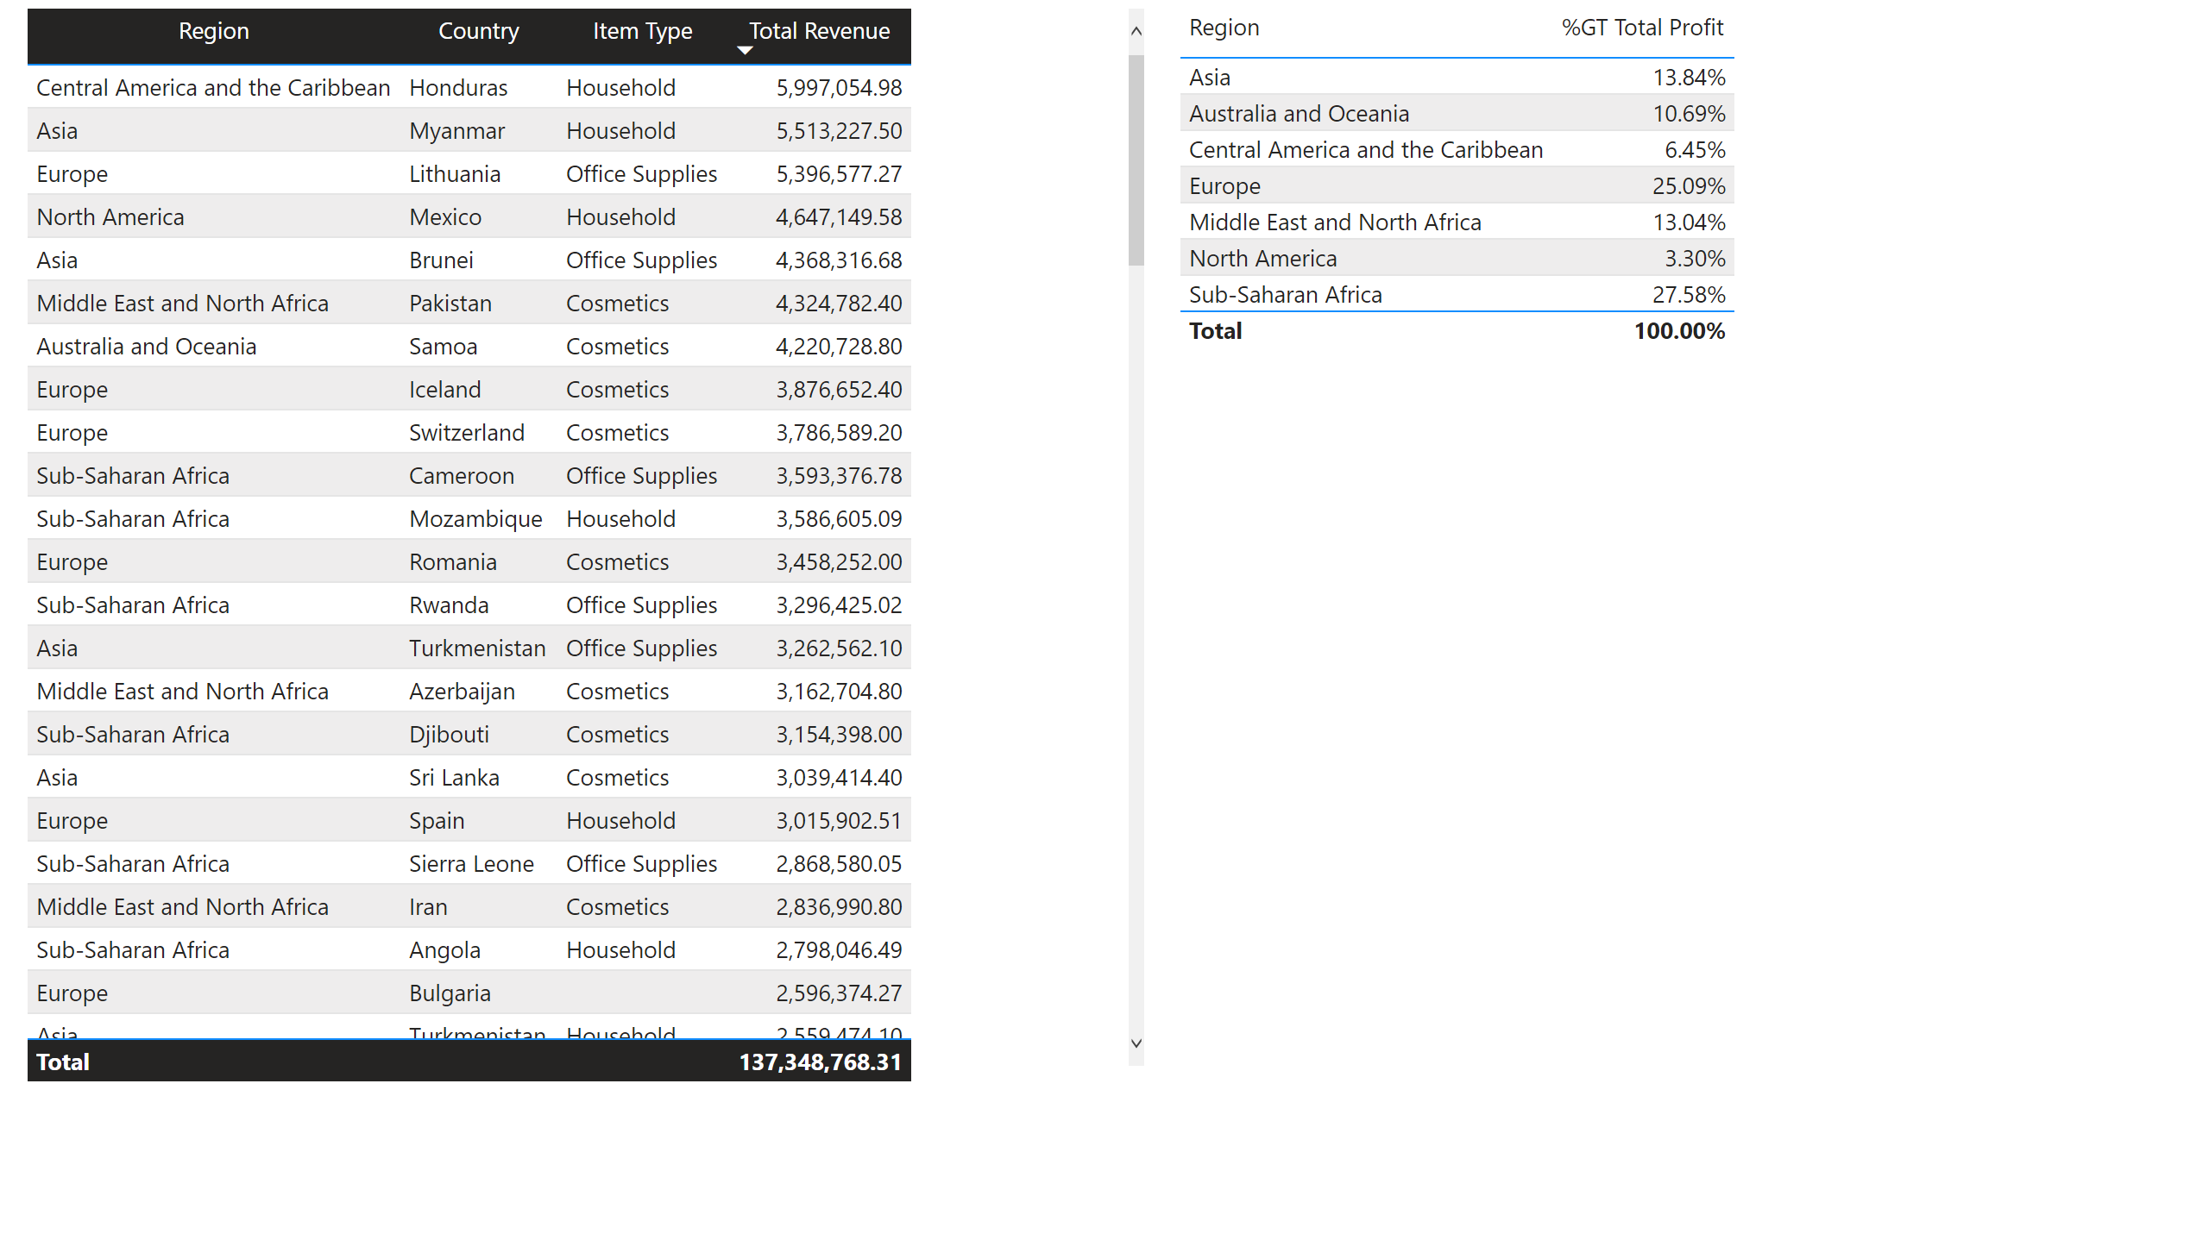
tabel
Notes:
tableEx
No alt text provided
tableEx
No alt text provided

Slide 10
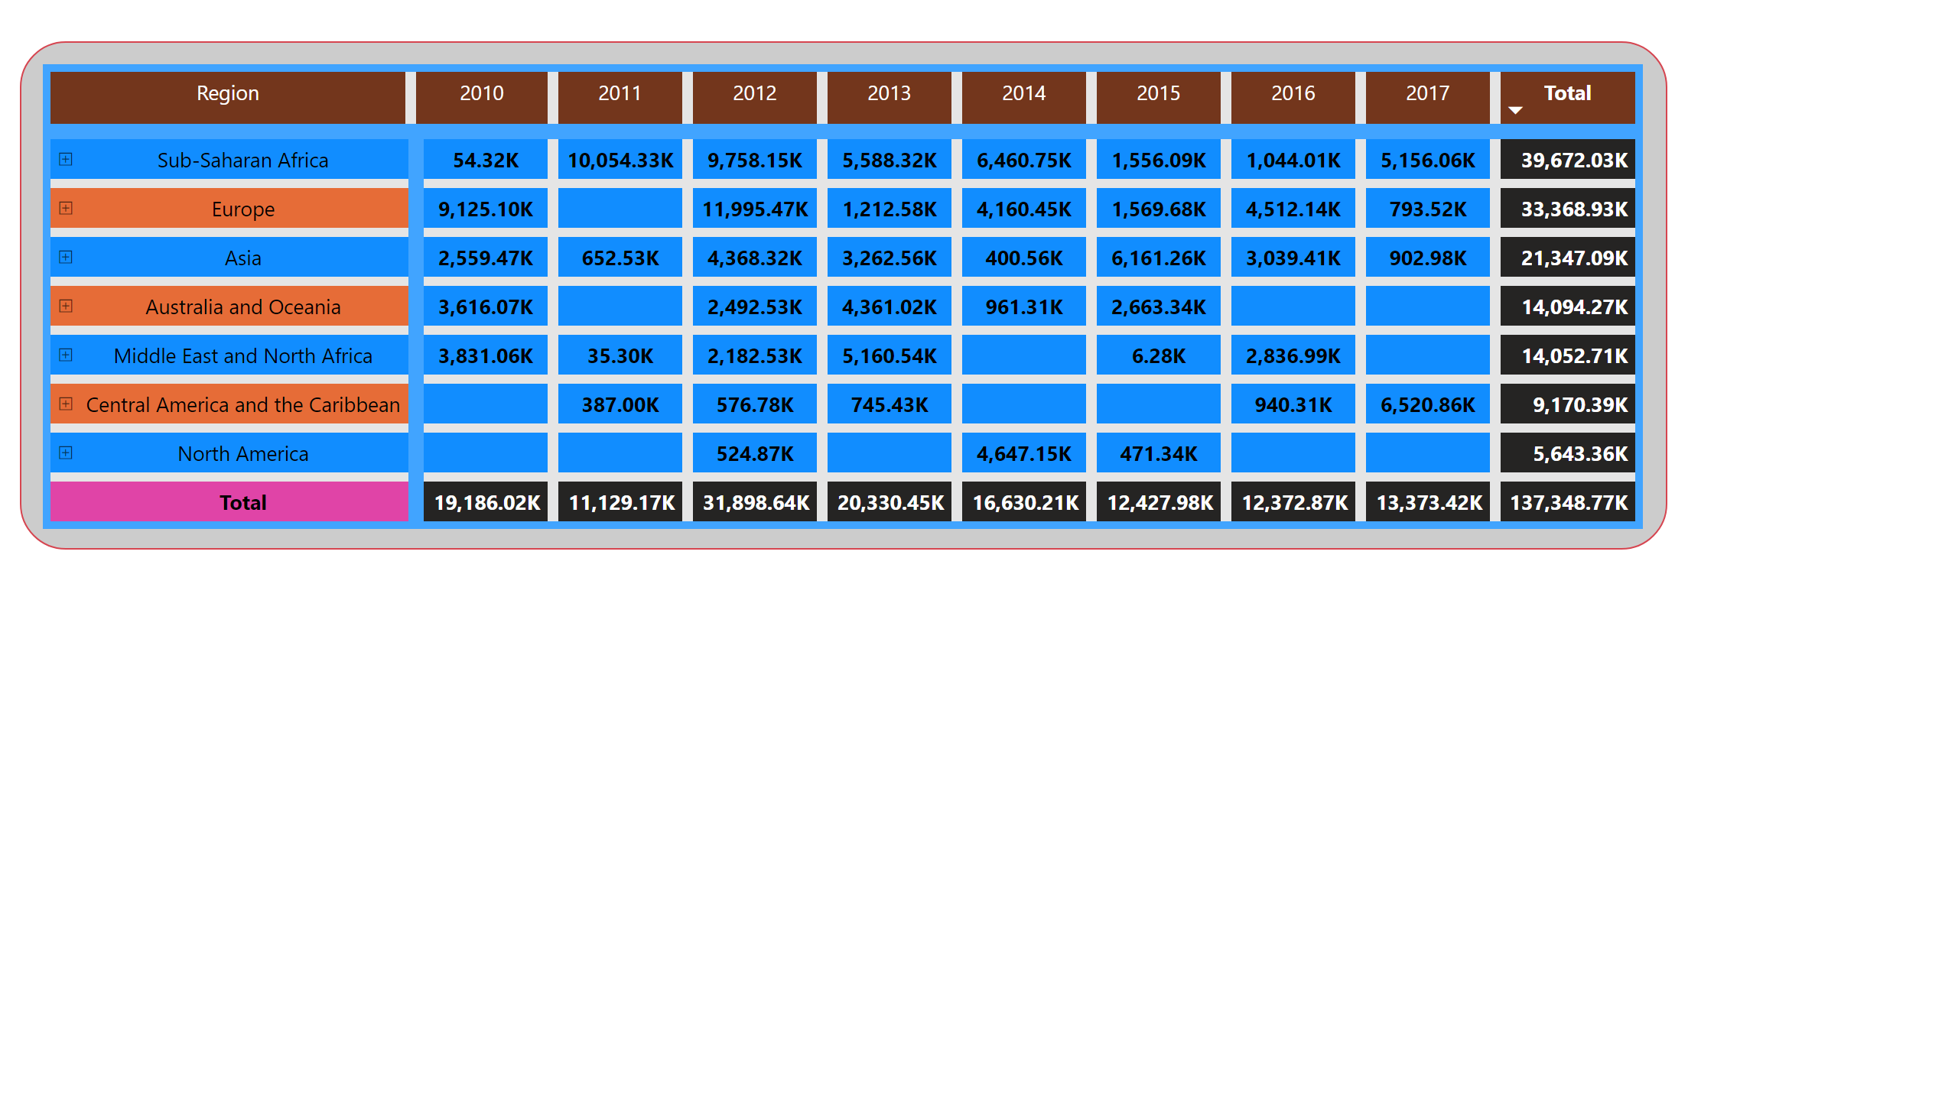
matrix
Notes:
pivotTable
No alt text provided

Slide 11
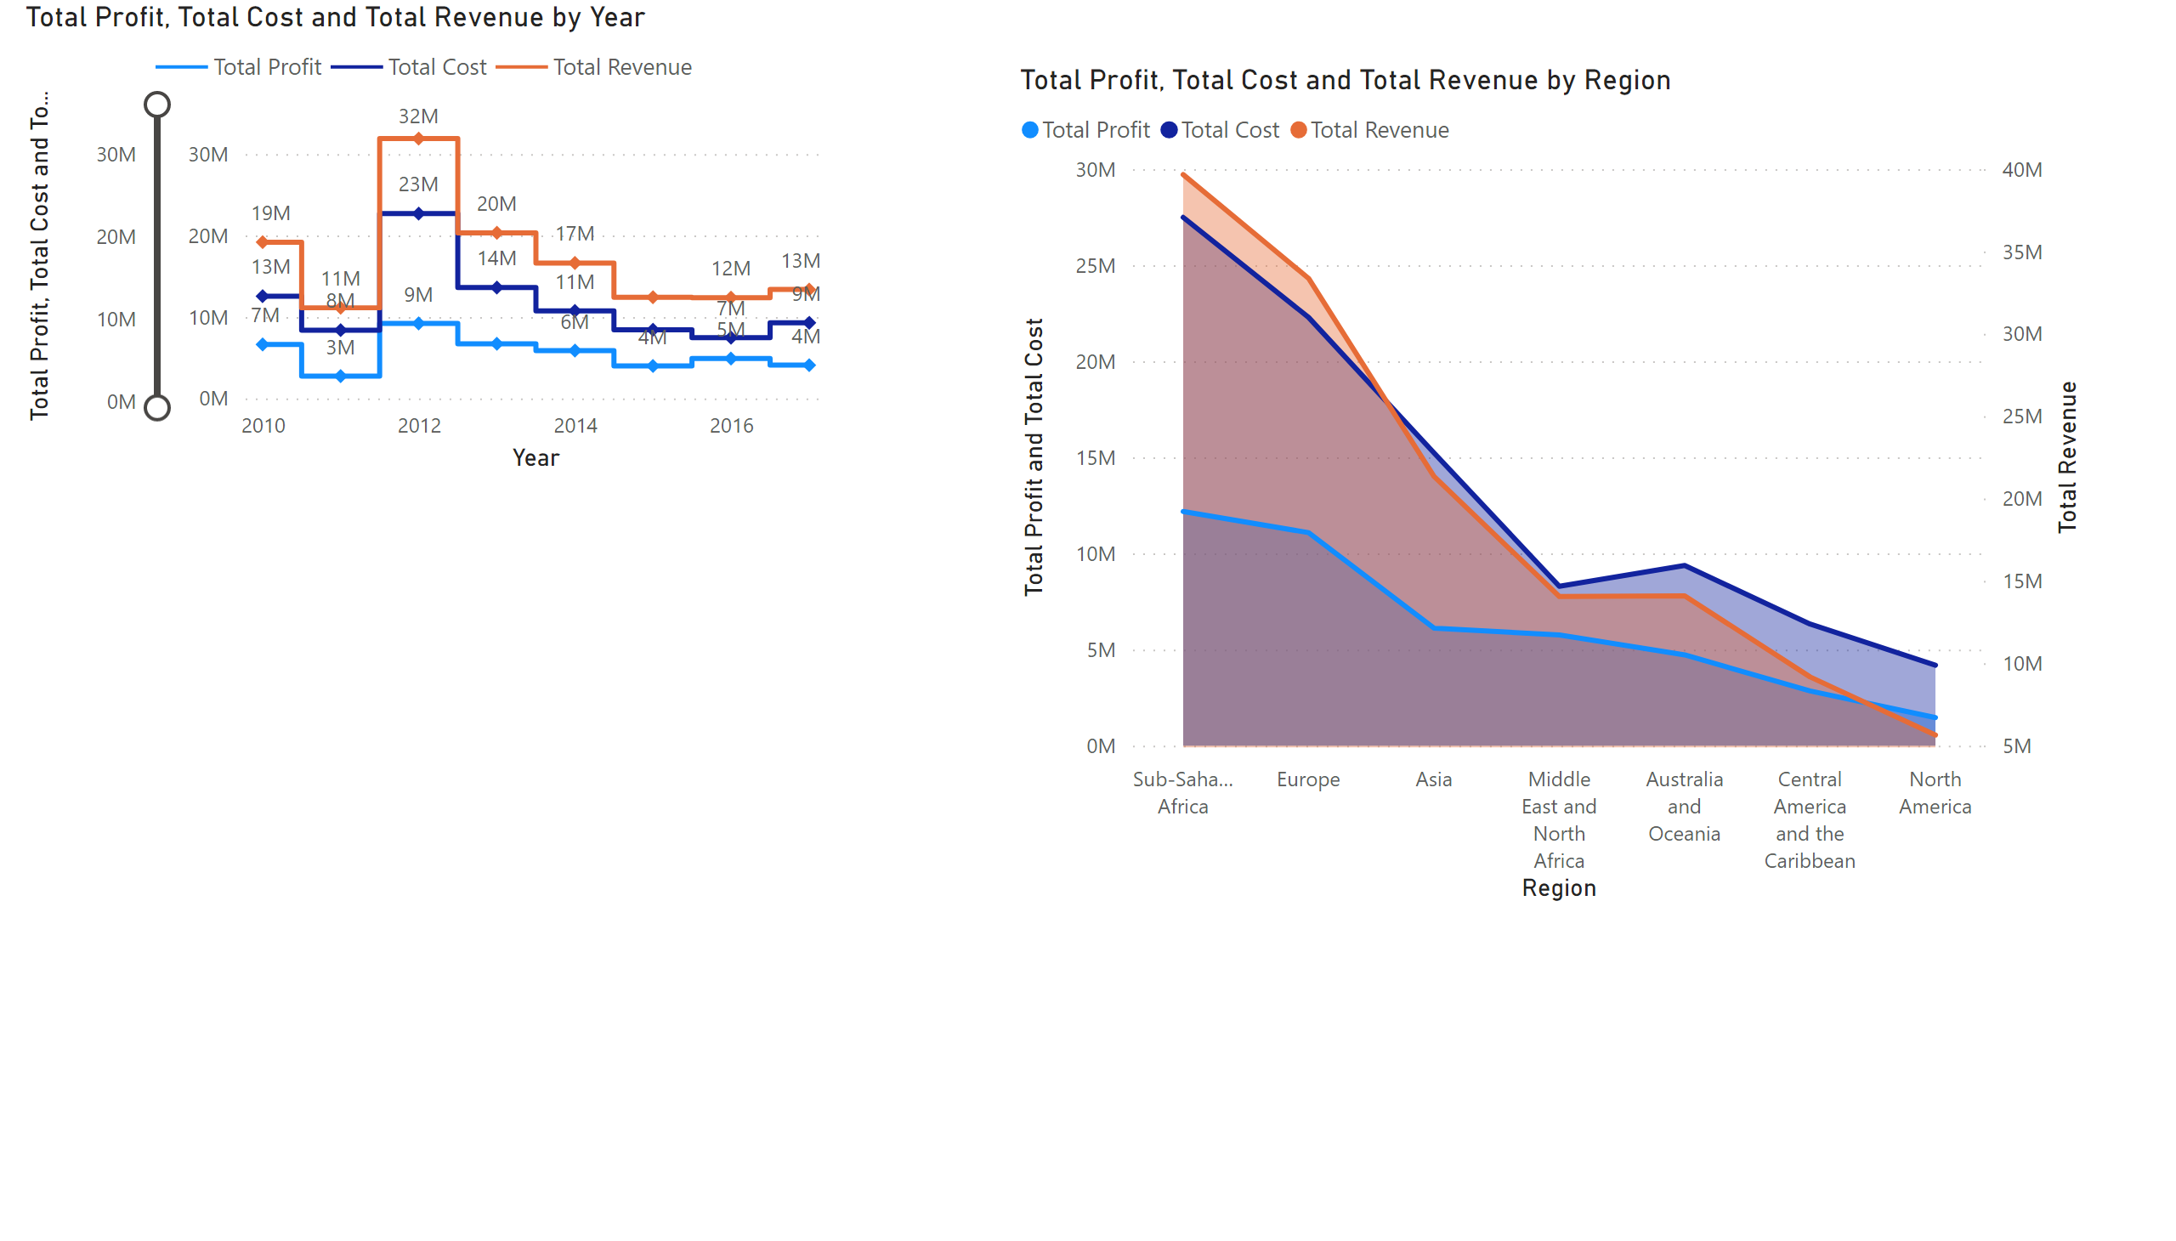
line chrt/area chart
Notes:
lineChart
No alt text provided
areaChart
No alt text provided

Slide 12
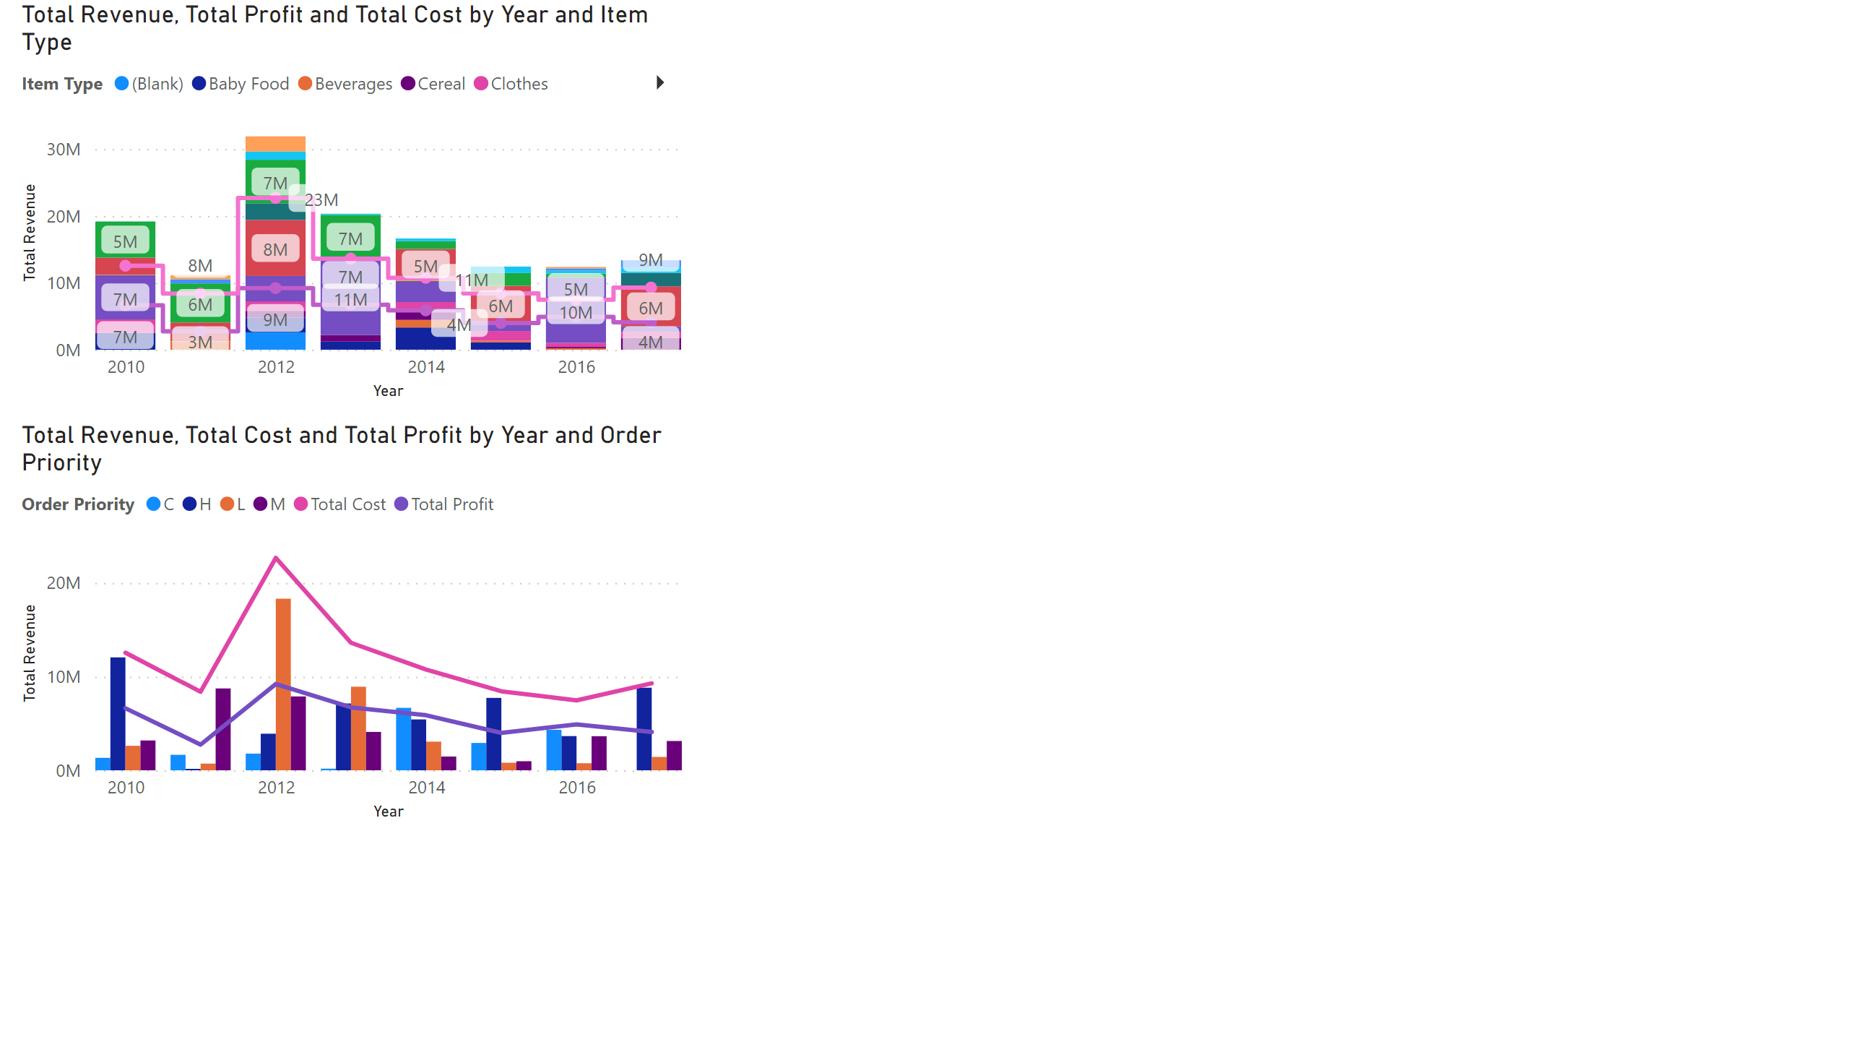
stacked chart 2 nos
Notes:
lineStackedColumnComboChart
No alt text provided
lineClusteredColumnComboChart
No alt text provided

Slide 13
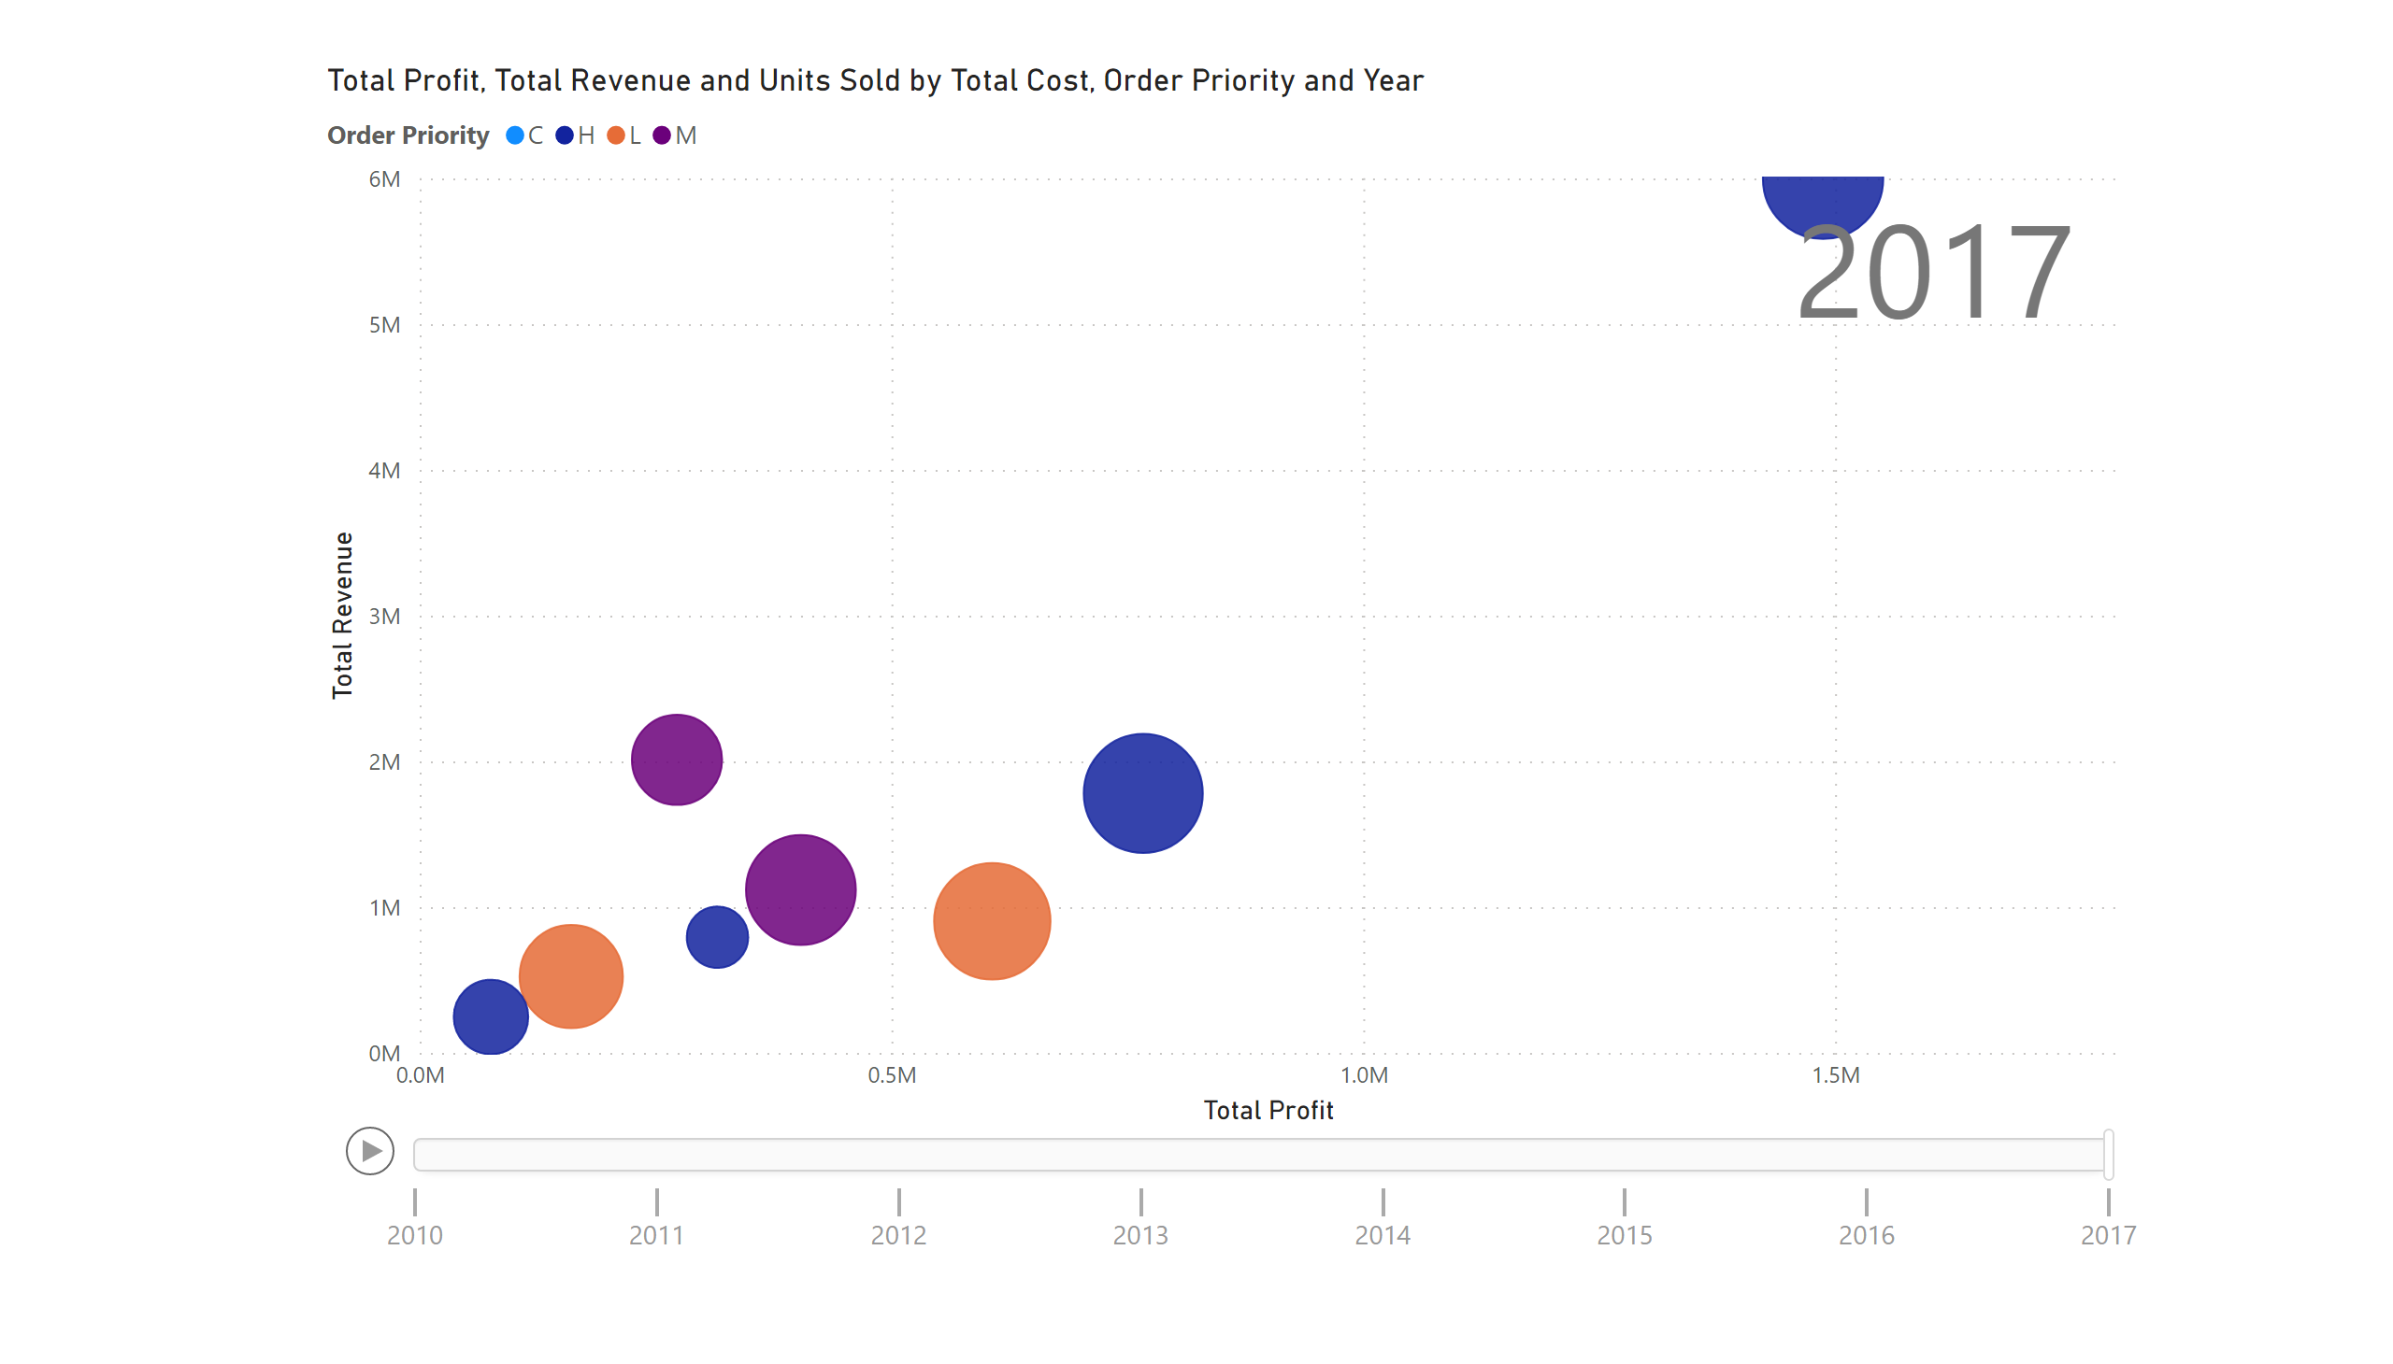
scttr plot
Notes:
scatterChart
No alt text provided

Slide 14
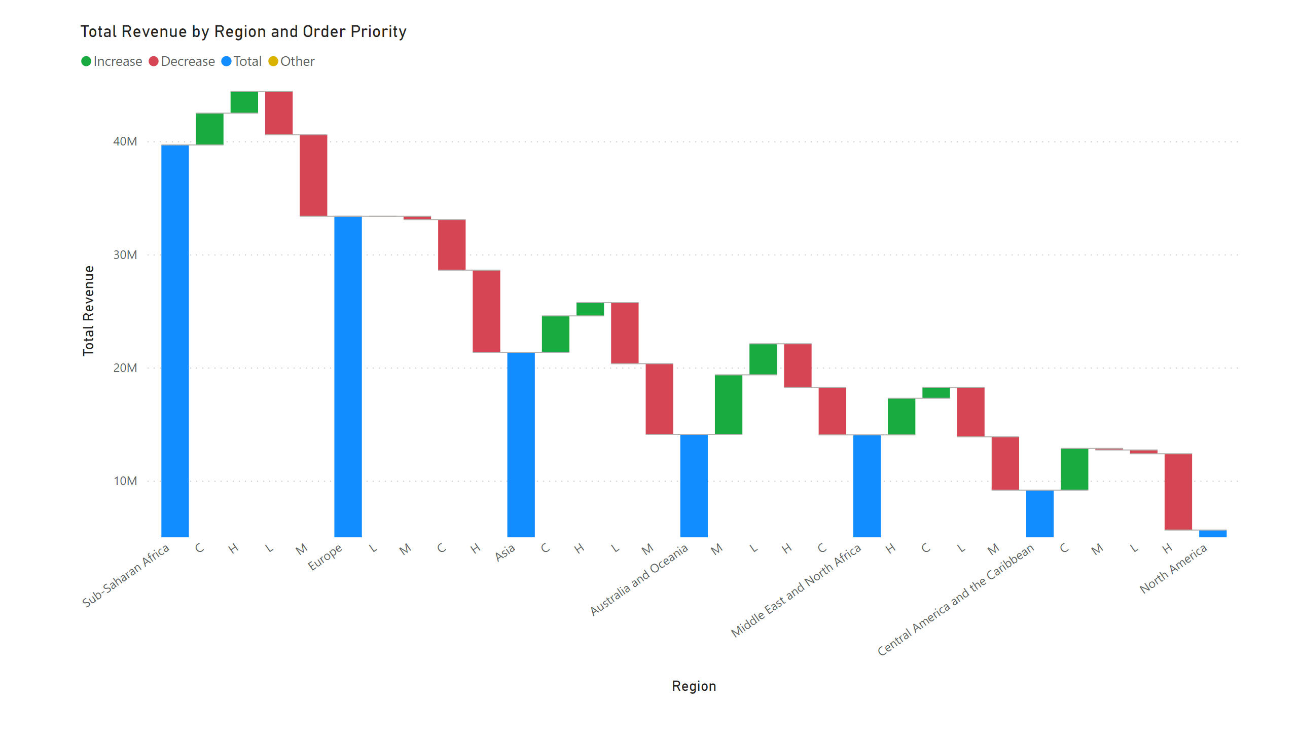
waterfall chart
Notes:
waterfallChart
No alt text provided

Slide 15
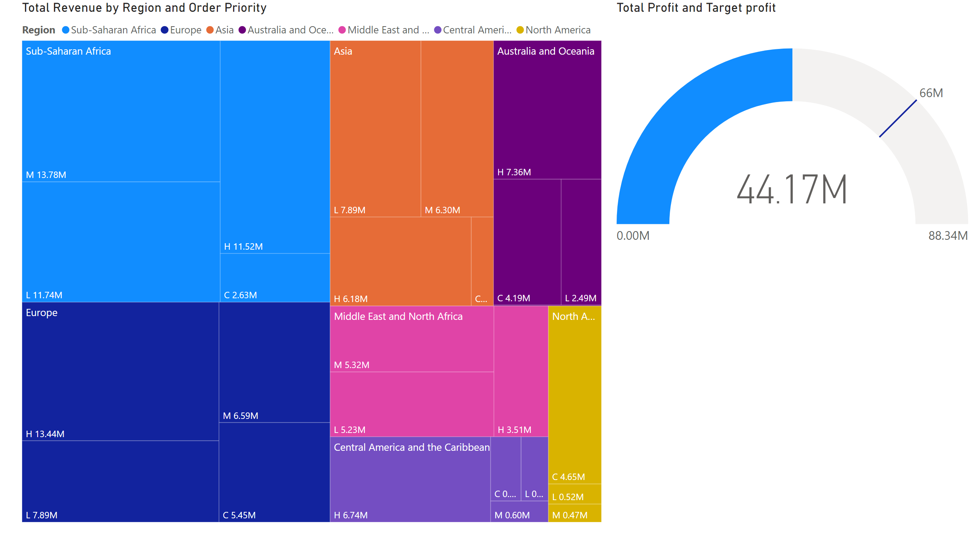
tree map /speedo meter
Notes:
treemap
No alt text provided
gauge
No alt text provided

Slide 16
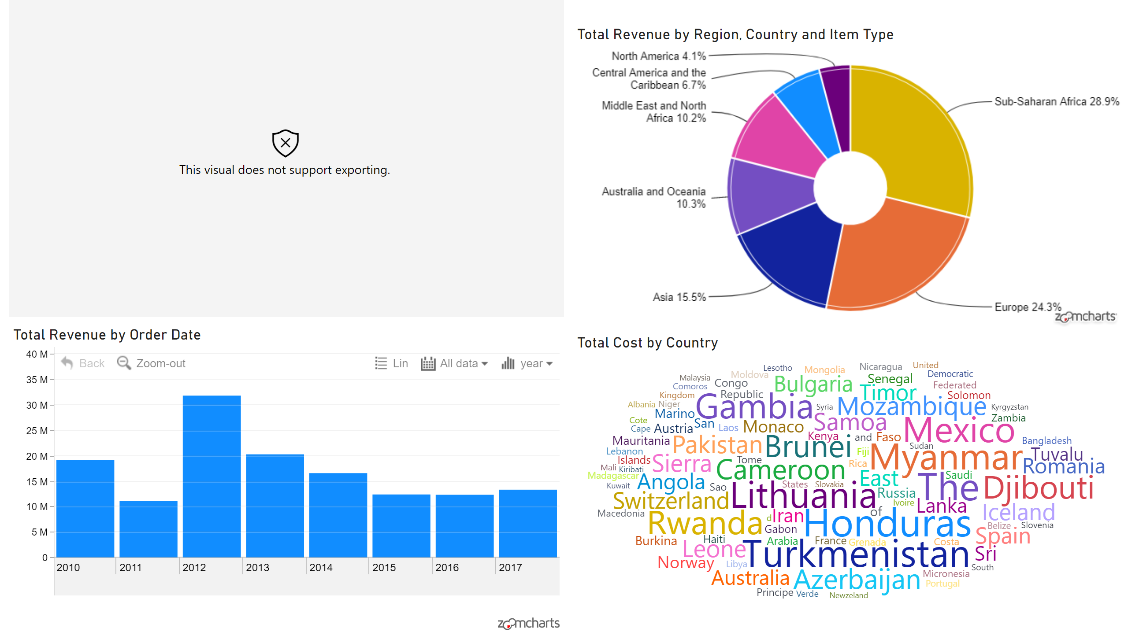
Page 1
Notes:
wishyoulizationbarchartrace
No alt text provided
ZoomChartsPieChartFree33C9F325D337408C98D4E1D4E1EAD703
No alt text provided
ZoomChartsTimeChartFree33C9F325D337408C98D4E1D4E1EAD705
No alt text provided
WordCloud1447959067750
No alt text provided

